Slide 1

Statistical Computation Methods for Data Science (6HC17)
By
Dr. Santhosh Nallapu
Assistant professor of Mathematics
Department of Science and Humanities
Sreenidhi Institute of Science and Technology
Yamnampet, Ghatkesar.
1
Notes:
1

Slide 2
We discuss the following in today’s Lecture
Multiple Linear Regression
Estimating the Regression Coefficients
Problems on Multiple Regression

Slide 3
Multiple Linear Regression
A regression model that involves more than one independent regression variable is called a multiple regression model.
Typically, For simple linear regression, we used the formula for a straight line, that is, we used the model: Y_{i} = β₀ + β₁X_{i}
For multiple regression, we include more than one independent variable and for each new independent variable, we need to add a new term in the model, such as:
Y= β₀ + β₁X₁+ β₂X₂ +…+ β_{n}X_{n} .

Slide 4
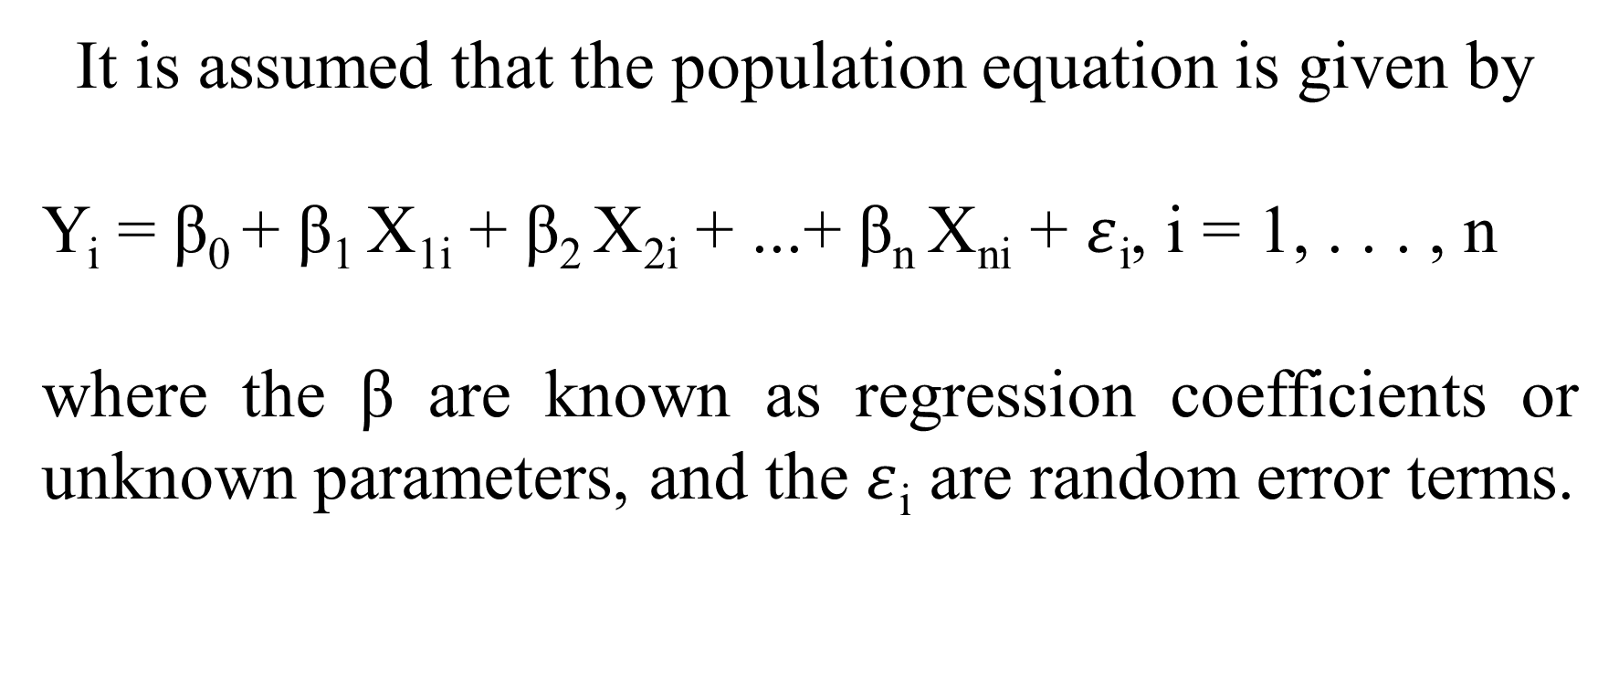
Multiple Linear Regression
It is assumed that the population equation is given by
Y_{i} = β₀ + β₁ X_{1i} + β₂ X_{2i} + ...+ β_{n} X_{ni} + $ε$_{i}, i = 1, . . . , n
where the β are known as regression coefficients or unknown parameters, and the $ε$_{i} are random error terms.

Slide 5
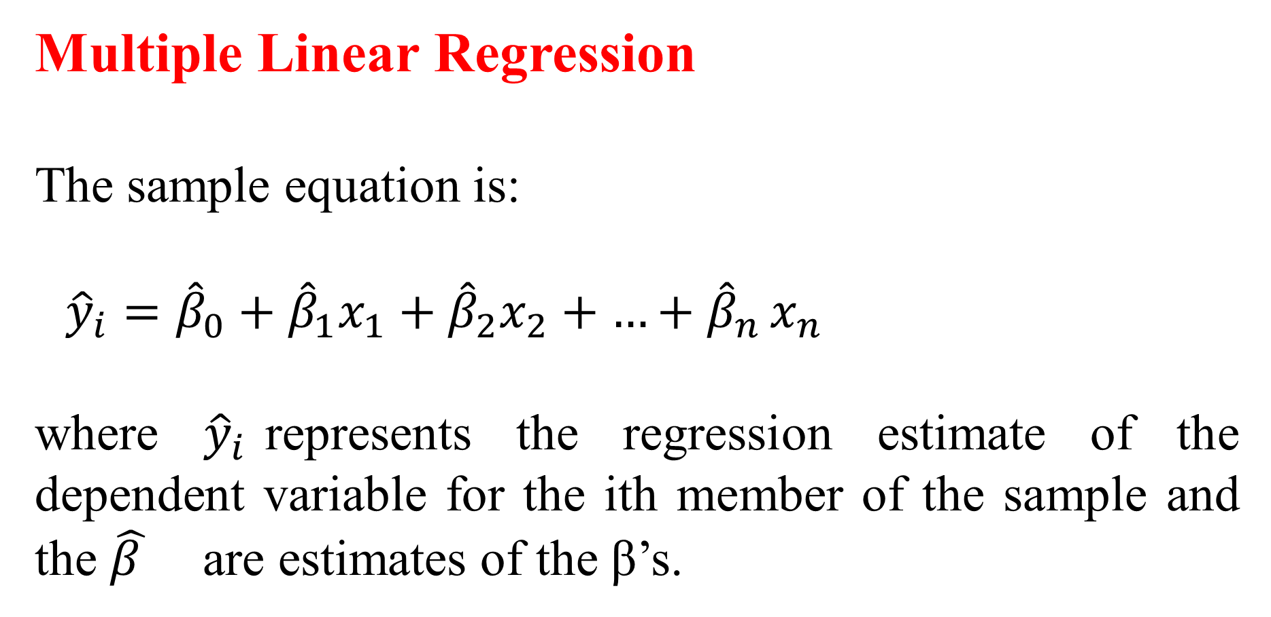
Multiple Linear Regression
The sample equation is:
${\hat{y}}_{i}={\hat{β}}_{0}+{\hat{β}}_{1}x_{1}+{\hat{β}}_{2}x_{2}+{…+\hat{β}}_{n}x_{n}$
where ${\hat{y}}_{i}$represents the regression estimate of the dependent variable for the ith member of the sample and the ${\hat{β }}_{}$ are estimates of the β’s.

Slide 6
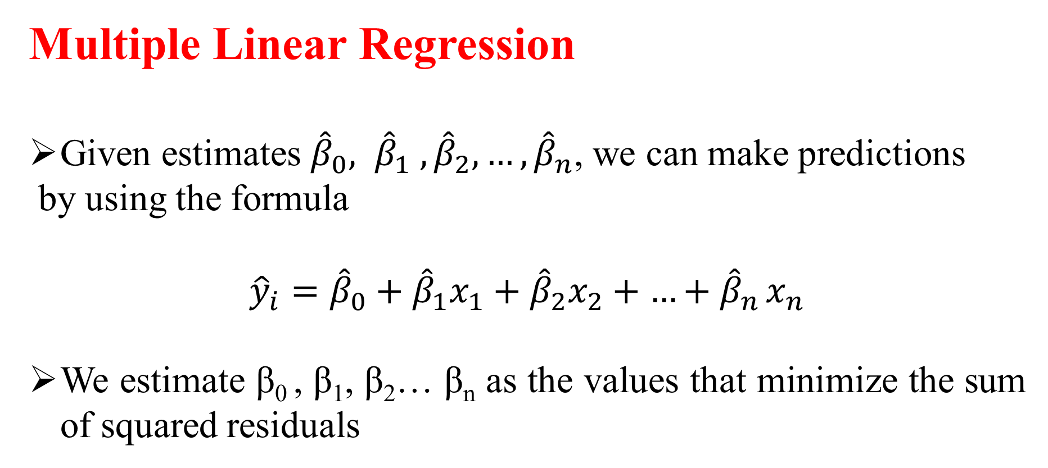
Multiple Linear Regression
Given estimates ${\hat{β}}_{0}, {\hat{β}}_{1} , {\hat{β}}_{2}{,…,\hat{β}}_{n}$, we can make predictions
by using the formula
$${\hat{y}}_{i}={\hat{β}}_{0}+{\hat{β}}_{1}x_{1}+{\hat{β}}_{2}x_{2}+{…+\hat{β}}_{n}x_{n}$$
We estimate β₀ , β₁, β₂… β_{n} as the values that minimize the sum of squared residuals

Slide 7
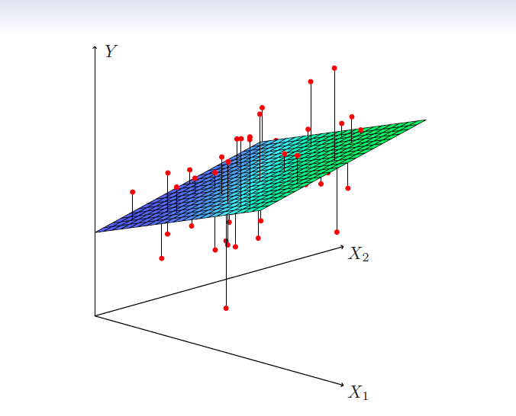

Slide 8

Estimating the Coefficients
The values ${\hat{β}}_{0}, {\hat{β}}_{1} , {\hat{β}}_{2}{,…,\hat{β}}_{n}$ that minimize RSS are the multiple least squares regression coefficient estimates. The multiple regression coefficient estimates have somewhat complicated forms. So, they can easily represented by using matrix algebra.
Note: For this reason, you can use any statistical software package to compute these coefficient estimates

Slide 9
Example : I
Estimate the correlation coefficients for the given data
Y | X1 | X2
90 | 3 | 16
72 | 5 | 10
54 | 6 | 7
42 | 8 | 4
30 | 12 | 3
12 | 14 | 2

Slide 10
SUMMARY OUTPUT | FOR EXAMPLE 1
Regression Statistics
Multiple R | 0.992707171
R Square | 0.985467526
Adjusted R Square | 0.975779211
Standard Error | 4.406289212
Observations | 6
ANOVA
 | df | SS | MS | F | Significance F
Regression | 2 | 3949.753846 | 1974.876923 | 101.7171157 | 0.0017519
Residual | 3 | 58.24615385 | 19.41538462
Total | 5 | 4008
 | Coefficients | Standard Error | t Stat | P-value | Lower 95%
Intercept | 61.4 | 13.66423368 | 4.493482872 | 0.020570377 | 17.91431001
X1 | -3.646153846 | 1.022469455 | -3.566027158 | 0.037658283 | -6.900107986
X2 | 2.538461538 | 0.819799369 | 3.096442414 | 0.053443823 | -0.070505935

Slide 11
Example : II
Estimate the correlation coefficients for the given data
Y | X1 | X2
12 | 1 | 10
18 | 2 | 1
24 | 3 | 2
30 | 4 | 3

Slide 12
SUMMARY OUTPUT | FOR EXAMPLE II
Regression Statistics
Multiple R | 1
R Square | 1
Adjusted R Square | 1
Standard Error | 1.77636E-15
Observations | 4
ANOVA
 | df | SS | MS | F
Regression | 2 | 180 | 90 | 2.85E+31
Residual | 1 | 3.15544E-30 | 3.15544E-30
Total | 3 | 180
 | Coefficients | Standard Error | t Stat | P-value
Intercept | 6 | 3.64045E-15 | 1.64815E+15 | 3.86E-16
X1 | 6 | 1.02558E-15 | 5.85035E+15 | 1.09E-16
X2 | 2.51215E-16 | 3.24317E-16 | 0.774596669 | 0.580431

Slide 13
Recapitulation:
Multiple Linear Regression
Estimating the Multiple Regression Coefficients

Slide 14
THANK YOU
Feed Back to santhoshn@sreenidhi.edu.in
Notes:
14

